Slide 1
End-to-End Automated Analytics and Machine Learning Workflow for SMBs
Mid-Evaluation Project Presentation
MANISH – (122AD0029)
SANKET – (122CS0006)
Department of Computer Science and Engineering

Slide 2

Contents
Introduction
Literature Review Research Gaps
Problem Statement Objectives
Proposed Methodology
Implementation and Results
Conclusion Future Work

Slide 3
The Challenge: Data Science for SMBs
Data-driven decision-making is a critical competitive advantage in today’s economy.
However, the process is often complex, requiring significant time, cost, and specialized expertise.
This creates a high barrier to entry for small and medium-scale businesses (SMBs) that lack dedicated data science teams.
The Core Problem
Fragmented workflows and manual, repetitive tasks slow down the journey from raw data to actionable insights, leaving valuable data assets underutilized.

Slide 4
The Solution: An Automated Workflow
This project introduces an End-to-End Automated Analytics and Machine Learning Workflow.
Our Goal: To build a seamless, low-cost pipeline that empowers businesses by automating the entire data science lifecycle.
Ingests raw tabular data (CSV).
Performs automated cleaning and analysis.
Trains and selects the best predictive model.
Generates insightful reports and dashboards.

Slide 5
Contents
Introduction
Literature Review Research Gaps
Problem Statement Objectives
Proposed Methodology
Implementation and Results
Conclusion Future Work

Slide 6
Foundational Concepts: AutoEDA and AutoML
Our work is built upon two pillars of modern data science:
Automated EDA (AutoEDA)
Automated Machine Learning (AutoML)
Automates model selection, hyperparameter tuning, and training.
Platforms like H2O AutoML systematically find the optimal model, democratizing advanced modeling.
Gap: Limited integration with a holistic exploratory and analytical workflow.
Automates the initial, time-consuming process of understanding a dataset.
Tools like ydata-profiling quickly generate reports on variable distributions, missing values, and correlations.
Gap: Often lacks seamless integration with downstream modeling processes.

Slide 7
State-of-the-Art: Towards Integrated Systems
The current research frontier is moving beyond these individual pillars and towards integrated, intelligent systems:
The Composable Workflow Concept (Bergman, D., et al., 2021): This influential paper argues for building a "composable toolkit" to automate the entire machine learning lifecycle. The core idea is that tools for data preparation, modeling, and deployment should not be isolated but should seamlessly connect in a flexible, end-to-end workflow. This highlights a shift from single-task automation to holistic process automation.
The Rise of Generative Analytics (Costa, V., et al., 2025): Recent and future-facing research explores the integration of Large Language Models (LLMs) with EDA and AutoML. This creates "Smart Tools" that can not only process data but also help interpret it, unlocking insights through natural language. This points to the next evolution where systems become not just automated, but also interpretive and conversational.

Slide 8
Research Gaps Identified
Generalization & Robustness Gap: Most open-source tools are brittle and demonstrated only on single, clean datasets.
Example Challenge: They often require significant re-coding to handle real-world variability (different column names, data types, etc.).
“Last Mile” Integration Gap: Tools for EDA and AutoML typically remain separate, requiring manual intervention to connect analysis stages.
Seamless Pipeline Need: A truly end-to-end pipeline that generates business-ready artifacts is still an implementation challenge.
Interpretation Gap for Non-Experts: AutoML platforms produce complex technical outputs that are difficult for non-expert business users to interpret.
Actionable Insights Needed: There is a need to translate technical results into understandable and actionable insights.

Slide 9
Research Gaps Identified
Our review highlights three critical gaps that hinder SMB adoption of data science:
Process Fragmentation: EDA, modeling, and reporting are often handled by separate, disconnected tools, requiring manual intervention.
Repetitive Manual Overhead: Analysts spend significant time writing repetitive code for cleaning and visualization for each new dataset.
Lack of Output Integration: Analytical outputs (charts, model files, reports) are typically fragmented, lacking a single, cohesive interface for business users.
Opportunity
There is a clear need for a unified platform that bridges these gaps, providing a single, automated path from raw data to actionable insight.

Slide 10
Contents
Introduction
Literature Review Research Gaps
Problem Statement Objectives
Proposed Methodology
Implementation and Results
Conclusion Future Work

Slide 11
Problem Statement
Small and medium-scale businesses face substantial barriers in leveraging data analytics due to:
Fragmented workflows
High expertise requirements
Significant time investments
Project Goal
To solve this, we are developing a comprehensive automated pipeline that ingests raw CSV data and automatically generates detailed EDA reports, interactive dashboards, and
high-performing predictive models suitable for business decision-making.

Slide 12
Project Objectives
Our primary technical objectives for this evaluation period were to:
Develop an Automated Pipeline: Create a seamless Python workflow integrating data cleaning, EDA, and AutoML.
Generate Comprehensive Reports: Automatically produce a static, detailed EDA report for deep analysis.
Create an Interactive Dashboard: Generate a dynamic, single-file dashboard with key business-centric visualizations.
Implement a Prediction Interface: Provide a functional, real-time prediction interface using the best-trained model.

Slide 13
Contents
Introduction
Literature Review Research Gaps
Problem Statement Objectives
Proposed Methodology
Implementation and Results
Conclusion Future Work

Slide 14
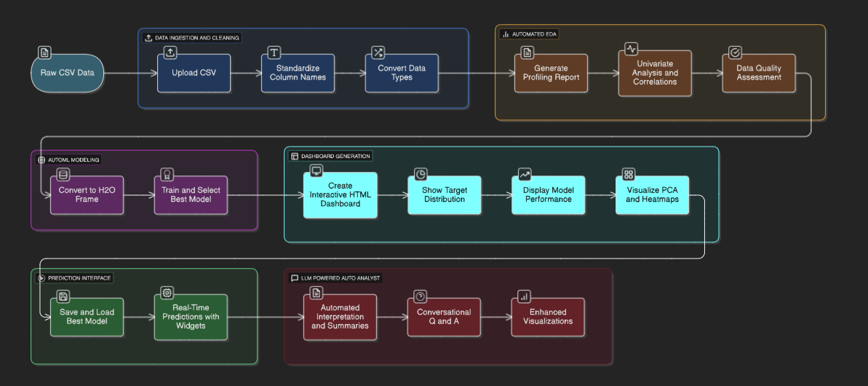
The 5-Stage Automated Workflow
Our project is implemented as a unified workflow within a single Jupyter Notebook.

Slide 15
Stage 1 & 2: Data Ingestion and Automated EDA
Data Ingestion & Cleaning:
The user uploads a raw CSV file.
The system automatically standardizes column names and converts data types.
Automated EDA with ydata-profiling:
This powerful library generates a comprehensive HTML report in seconds.
It covers univariate analysis, correlations, and data quality warnings.
Example Code Snippet
1 from ydata_profiling import Profile Report
2 profile = Profile Report ( df , title =" Auto EDA Report")
3 profile . to_file (" eda_report . html")

Slide 16
Stage 3: AutoML Modeling with H2O
Automated Model Training and Selection:
The cleaned data is converted into an H2OFrame.
H2O AutoML engine is run to train and evaluate a wide range of models (GBMs, XGBoost, Stacked Ensembles).
It automatically identifies the best-performing model based on cross-validation metrics.
Example Code Snippet
1 from h2o . automl import H 2 OAuto ML
2 aml = H 2 OAuto ML( max_runtime_secs =300 , seed =1)
3 aml. train ( x= predictors , y= target , training_frame = h 2o_df)
4 leader_model = aml. leader

Slide 17
Stage 4 & 5: Dashboard and Prediction
Interactive Dashboard Generation:
A custom, single-file HTML dashboard is programmatically generated.
It uses Chart.js to create interactive visualizations for:
Target Distribution
Model Performance (Actual vs. Predicted)
Cluster Analysis (PCA)
Correlation Heatmap
Prediction Interface:
The best model is saved and loaded.
A simple, interactive prediction form is created using ipywidgets.

Slide 18
Contents
Introduction
Literature Review Research Gaps
Problem Statement Objectives
Proposed Methodology
Implementation and Results
Conclusion Future Work

Slide 19
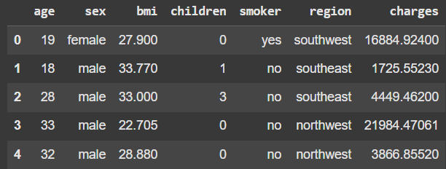
Case Study: Insurance Dataset
To validate the workflow, we used the publicly available ‘insurance.csv‘ dataset.
Dataset Characteristics:
Observations: 1,338
Features: 7 (age, sex, bmi, children, smoker, region, charges)
Data Types: Mix of numerical and categorical data.
source/dataset_sample.png
Prediction Task:
Predict the medical insurance charges
(a regression problem).

Slide 20
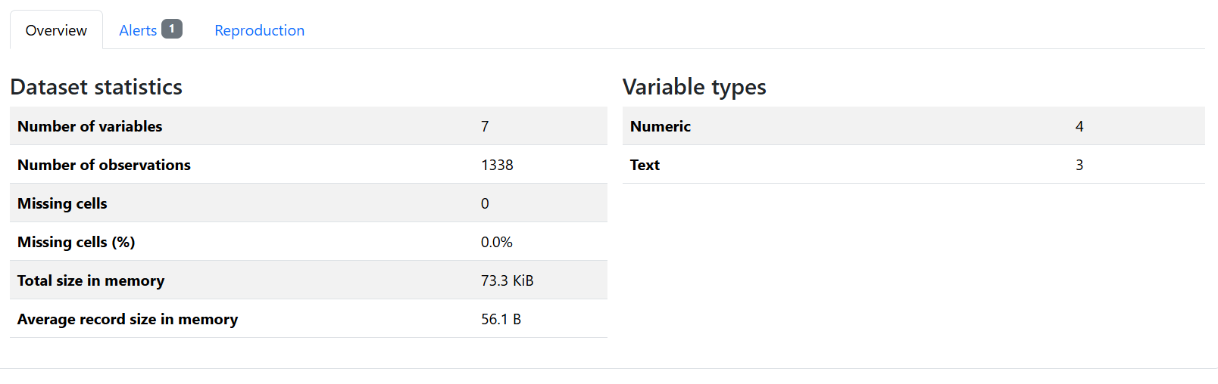
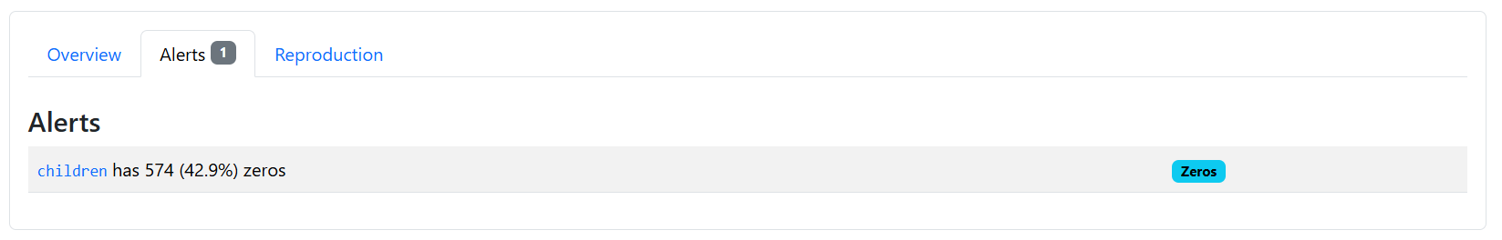
Deliverable 1: Automated EDA Report
The pipeline successfully generated a comprehensive EDA report.

Slide 21
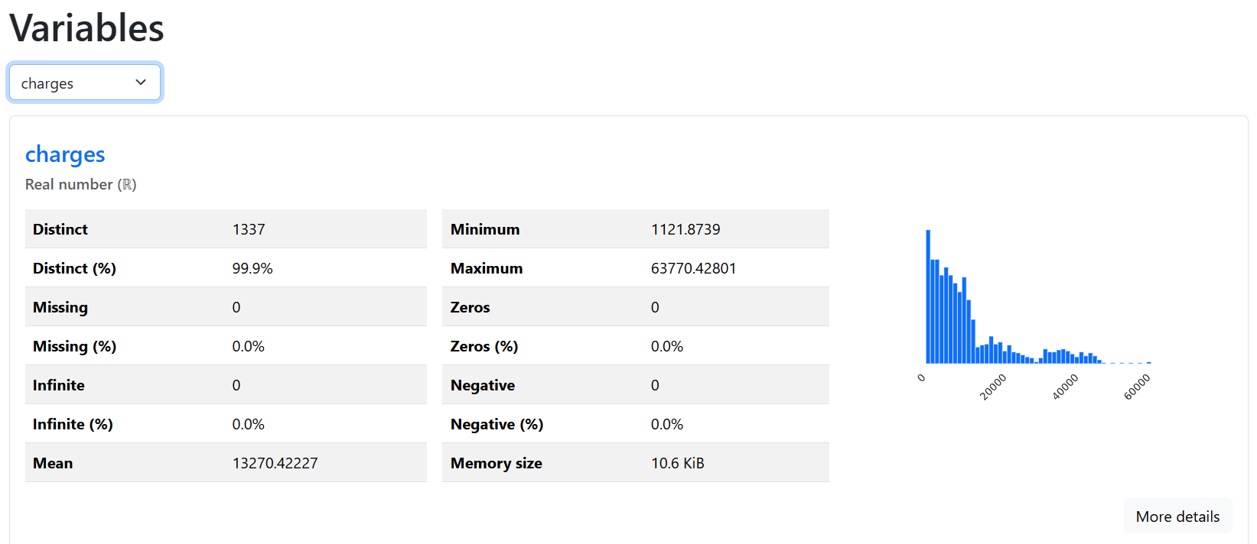
Automated EDA Report

Slide 22
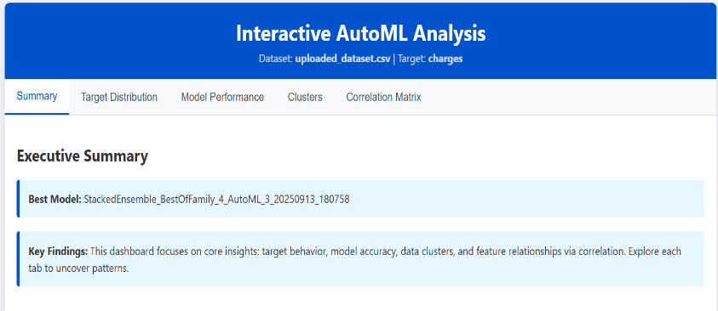
Deliverable 2: Interactive Dashboard
An interactive HTML dashboard was generated, providing a user-friendly way to explore results.
Features:
Tabbed navigation for different sections.
Interactive charts powered by Chart.js.
Single-file output for easy sharing.

Slide 23
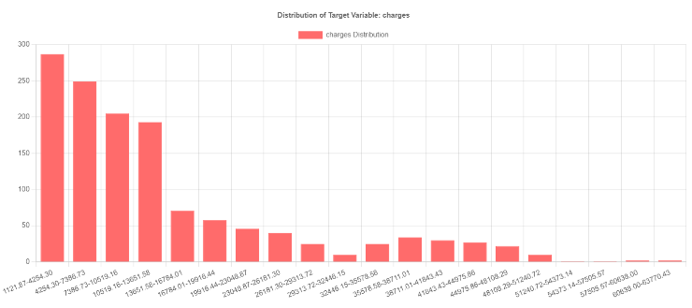
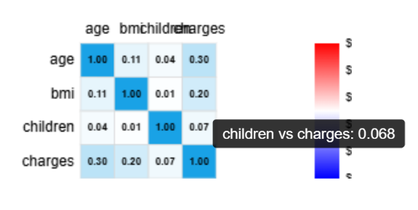
Dashboard Deep Dive: Key Visualizations
The dashboard provides critical at-a-glance insights.

Slide 24
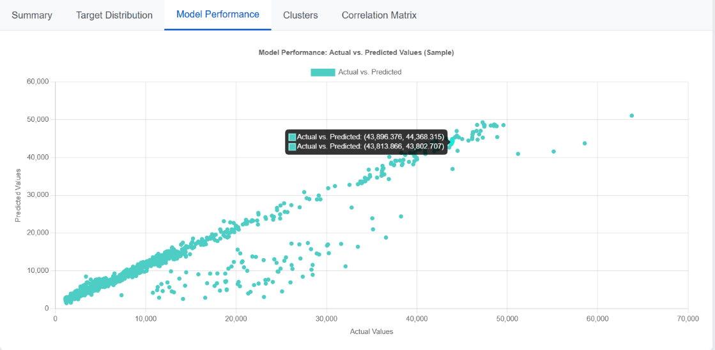
Model Performance Results
Distribution of Target Variable:

Slide 25
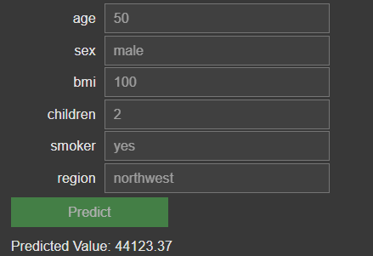
Model Testing Interactive Dashboard

Slide 26
Quantifiable Impact: Efficiency Gains
This automated workflow provides significant, measurable benefits for SMBs.
Time Reduction
Manual EDA Process: 2-4 hours
Automated Workflow: 5-7 minutes
Time Savings: 85%
Productivity Enhancement
Automates the most time-consuming tasks.
Allows users to focus on interpretation, not coding.
Productivity Increase: 50%

Slide 27
Contents
Introduction
Literature Review Research Gaps
Problem Statement Objectives
Proposed Methodology
Implementation and Results
Conclusion Future Work

Slide 28
Conclusion
We have successfully developed a robust, end-to-end workflow that automates the data analysis lifecycle.
The system was validated, proving its technical feasibility and its ability to generate business-ready outputs.
The demonstrated time and cost reductions confirm that the project objectives for this evaluation period have been met.
This provides a powerful, low-cost analytical foundation for SMBs.

Slide 29
Future Work: The Road Ahead
The next phase will focus on integrating a Large Language Model (LLM) to evolve this workflow into a ”Generative Auto-Analyst”.
Automated Interpretation: The LLM will generate natural language summaries of charts and results, making insights more accessible.

Slide 30
Future Work: The Road Ahead
The next phase will focus on integrating a Large Language Model (LLM) to evolve this workflow into a ”Generative Auto-Analyst”.
Automated Interpretation: The LLM will generate natural language summaries of charts and results, making insights more accessible.
Conversational Q&A Interface: Users will be able to ask questions about their data (e.g., ”What is the correlation between age and charges?”) and receive answers in plain English.

Slide 31
Future Work: The Road Ahead
The next phase will focus on integrating a Large Language Model (LLM) to evolve this workflow into a ”Generative Auto-Analyst”.
Automated Interpretation: The LLM will generate natural language summaries of charts and results, making insights more accessible.
Conversational Q&A Interface: Users will be able to ask questions about their data (e.g., ”What is the correlation between age and charges?”) and receive answers in plain English.
Enhanced Visualizations: We plan to add more chart types and interactive features based on user feedback.

Slide 32
References
Bergman, D., et al. (2021). Automating the End-to-End Machine Learning Lifecycle with a Composable Toolkit. Proceedings of the Conference on Machine Learning and Systems (MLSys).
Costa, V., et al. (2025). A Smart Tool to Unlock Hidden Insights in Industrial Data by Leveraging EDA, LLM, Conformal Prediction, and AutoML. ResearchGate Publication.
H2O.ai team. (2020). H2O AutoML: Scalable Automatic Machine Learning. H2O.ai.
Karmaker, S. K., et al. (2024). Automated machine learning: past, present and future.
Artificial Intelligence Review.
Shen, Y., et al. (2025). Evaluation of large language model-driven AutoML in data and model management from human-centered perspective. Frontiers in Artificial Intelligence.

Slide 33
Thank You

